Slide 1
Predicting Hospitalization Risk
from Wearable Accelerometry
Using CDC NHANES DATA
Grayson Grabois
Eddie Lin

Slide 2
Where the Data Comes From
NHANES 2005-2006
National Health and Nutrition Examination Survey
Run by the CDC and designed to represent the U.S. population
Participants received a full physical health checkup
In 2005, they also gave out a hip-worn accelerometer
Worn for 7 consecutive days
Records movement every minute
From Accelerometer:
Motion intensity - how hard the body was moving
Step count
From Health Check-up:
BMI, blood pressure, waist circumference, age, sex
Self-reported: # of hospitalizations in the past 12 months?

Slide 3
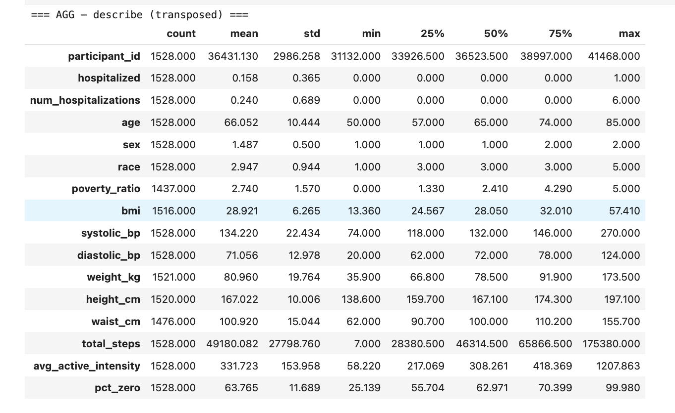
About the Data
1,528 patients in our dataset
Age range: 50 to 85 years old
15.7% were hospitalized in the past year (238 patients)
Avg age: 66
Avg Weight: 81kg
Avg Weekly Step Count: 49,180
Avg Intensity: 332 (SD of 154)
Avg BMI: 28.9
Avg Systolic BP: 134 mmHG
(Average Patient has hypertension)
Clean/Filtered:
3 Patients with no intensity
20 Impossible Systolic BP
52 NaN BMI

Slide 4
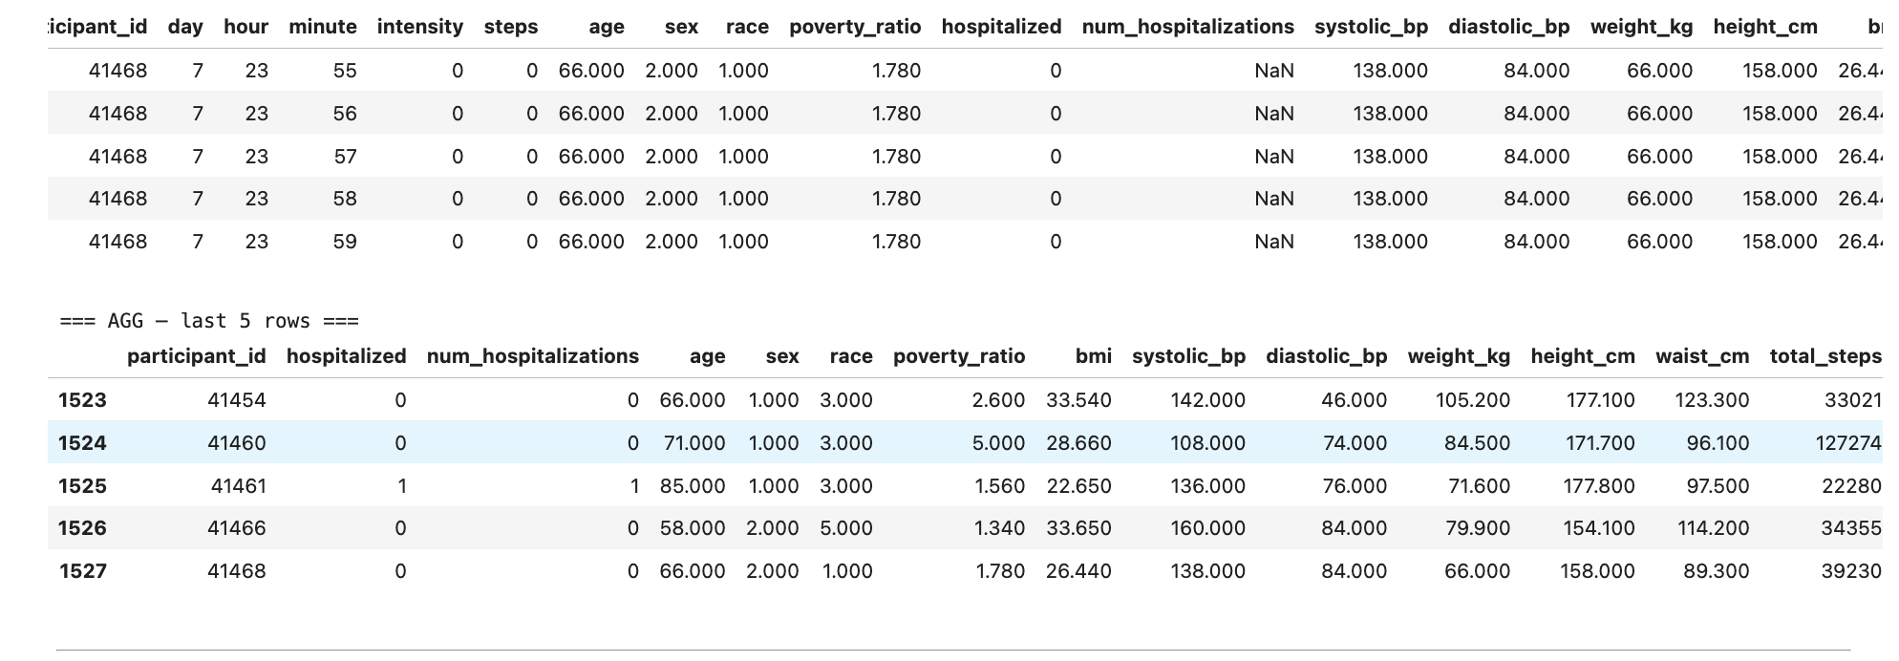
From 15 Million Rows to 1,528 Patients
Raw data: one row per minute, per patient, across 7 days
15,383,678 rows → 1,528 patients
Per-patient features were aggregated:
Total steps - summed across 7 days
Avg active intensity - intensity only when active
% at 0 - amount of time with no intensity
Joined with clinical data from
NHANES checkup:
BMI, systolic blood
pressure, waist circumference,
age, sex, hospitalizations
Result: 2 Datasets
Per minute per patient (for time series)
Patient health data with aggregated activity data (1 row per patient)

Slide 5
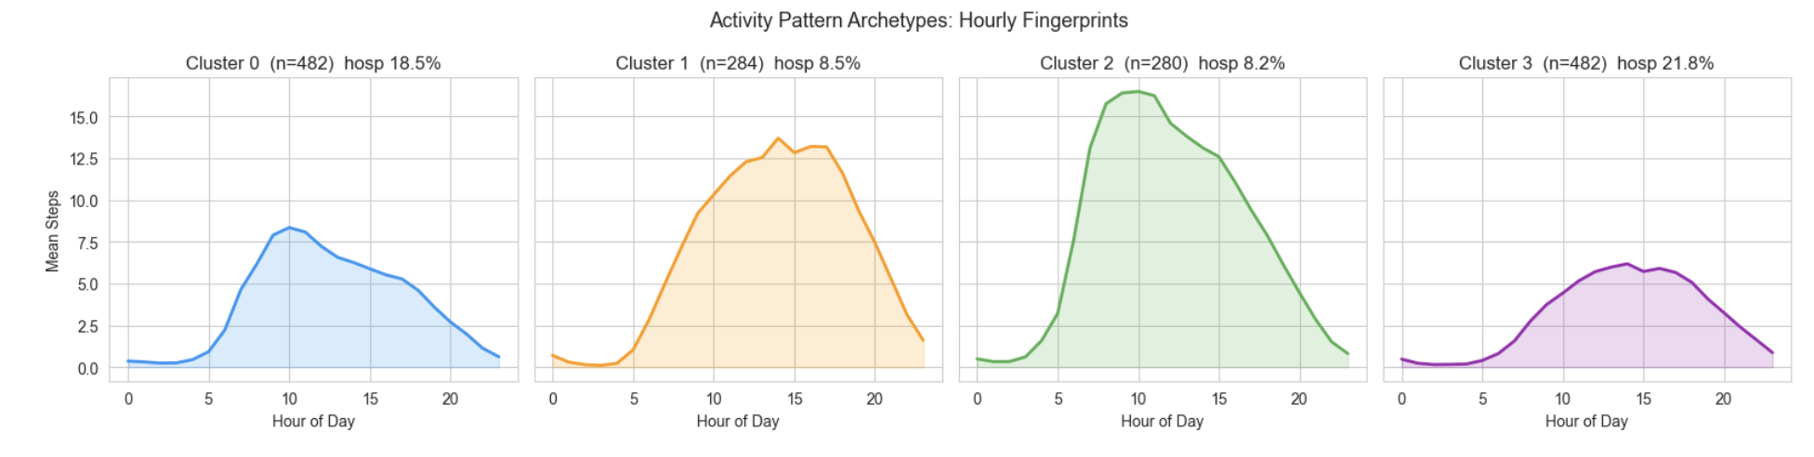
Initial Observation: Hospitalized vs. Non-Hospitalized
Non-Hospitalized (in the past year) are generally more active than hospitalized patients
Our next steps are:
Figuring out how time of day and other factors contribute to health and hospitalizations
How to determine risk of hospitalizations based on these factors
Predicting Activity based on min by min tracking

Slide 6
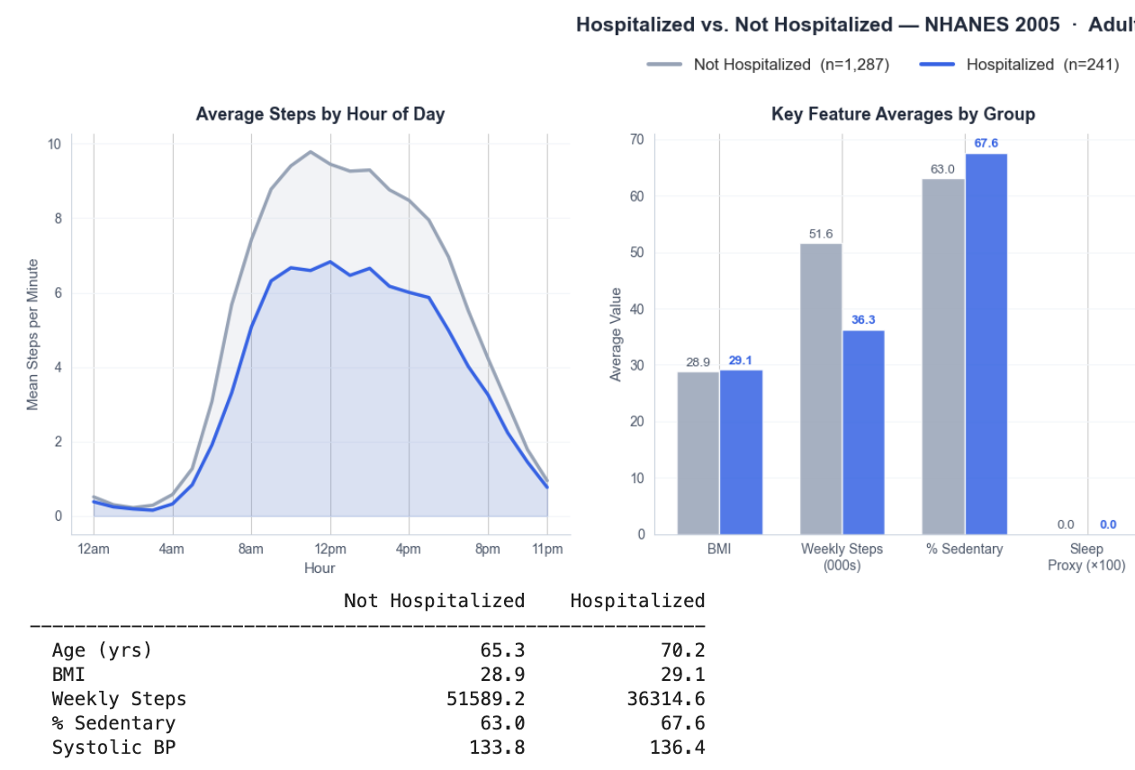
The Finding
Active patients were hospitalized at half the rate of inactive ones.
Not Hospitalized
51,800 avg steps/week
Hospitalized
36,500 avg steps/week
~15,000 step gap — p < 0.0001
The gap shows up in every metric:
Higher BMI · More sedentary time · Lower systolic BP in active group
15.7% of the dataset was hospitalized (238 / 1,516 patients)

Slide 7
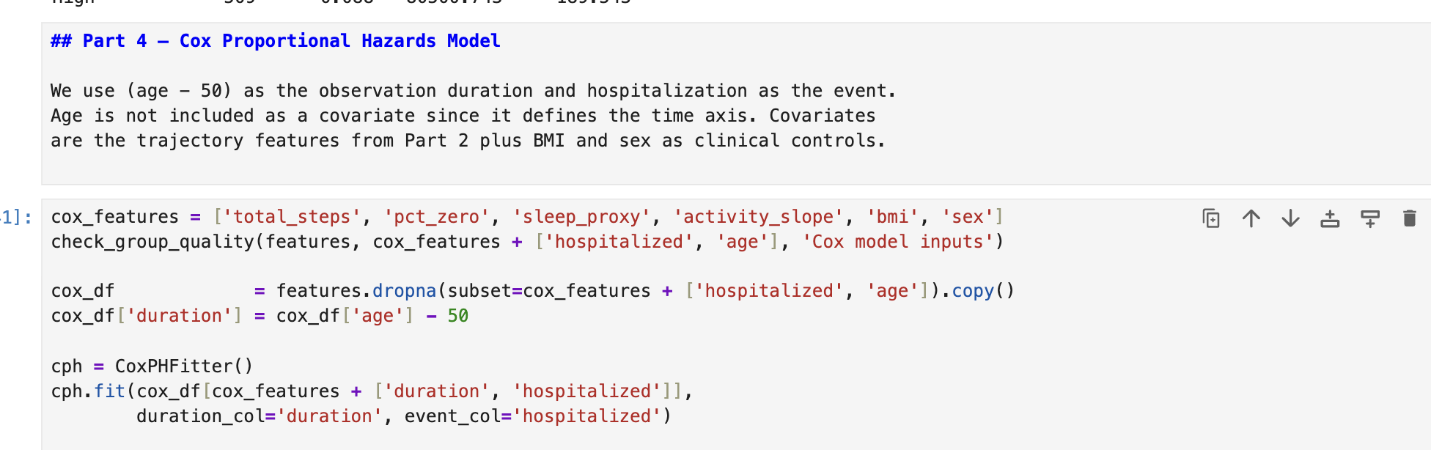
We Tried to Quantify It
A Cox Proportional Hazards Model assigns a weight to each factor and asks:
how much does each variable independently contribute to hospitalization risk?
6 Inputs:
Total weekly steps
% of time sedentary
Sleep proxy (nighttime stillness)
Activity slope (7-day trend)
BMI
Sex
Accuracy — C-index: 0.639
0.50 = coin flip 0.65+ = clinically useful 1.0 = perfect
1,516 patients · 238 hospitalizations
To test it, we paired every hospitalized patient with every non-hospitalized patient and found that it guessed the hospitilzed person right 63.9% of the time.
Gradient Boosting or Random Forest might perform better

Slide 8
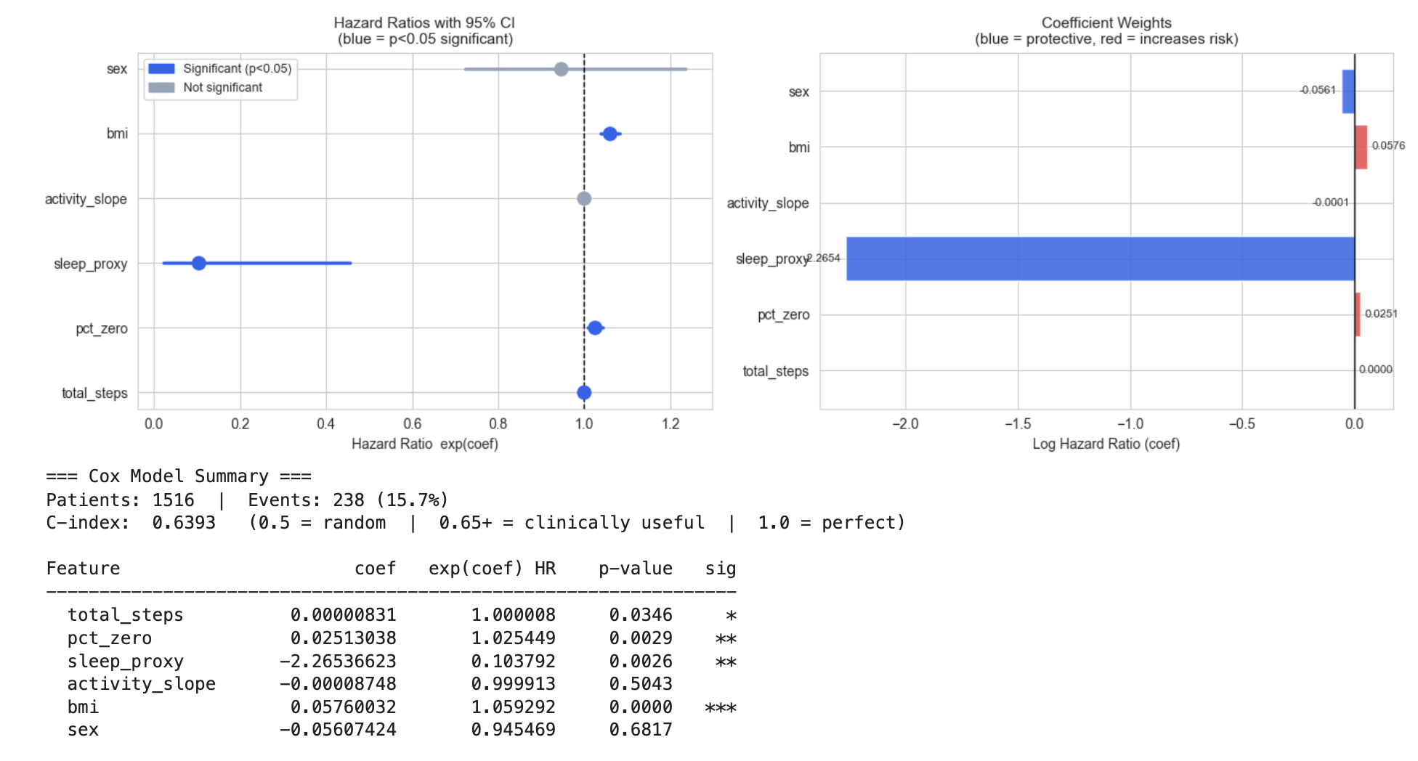
What Actually Drives the Risk
Total Steps — barely registers
Once sleep proxy and BMI are in the model, steps adds little.
Sleep Proxy — HR = 0.104
The single largest weight in the model.
A unit increase cuts hospitalization hazard to 10% of baseline.
BMI — p < 0.0001
Most statistically reliable predictor.
Each BMI unit adds ~5.9% to hazard.
BMI 35 vs BMI 25 = roughly 1.8x the risk.
Activity Slope — p = 0.504 (no effect)
7 days is not enough to detect a trend.

Slide 9
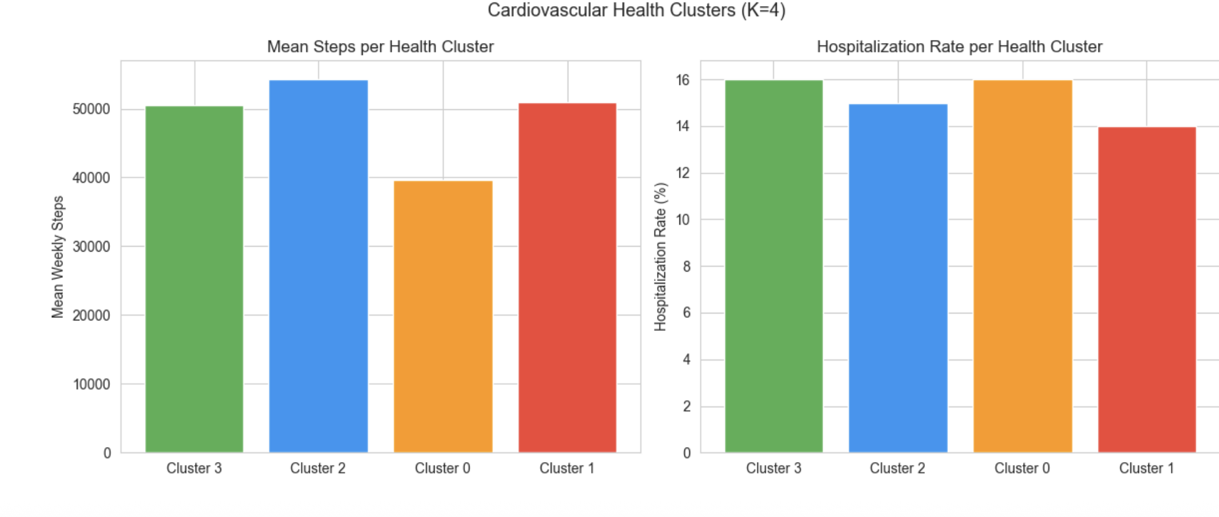
But Who Are These Active People?
K-means clustering on health markers revealed two distinct groups,
not a spectrum.
High-Activity Clusters (69k – 80k steps/week)
8 – 8.5% hospitalization rate
Lower BMI · Lower blood pressure
Low-Activity Clusters (30k – 38k steps/week)
19 – 22% hospitalization rate
Higher BMI · Higher blood pressure
Active patients are not just people who walk more.
They have a different metabolic profile entirely.
This raises the question:
Does activity cause health, or does health enable activity?

Slide 10
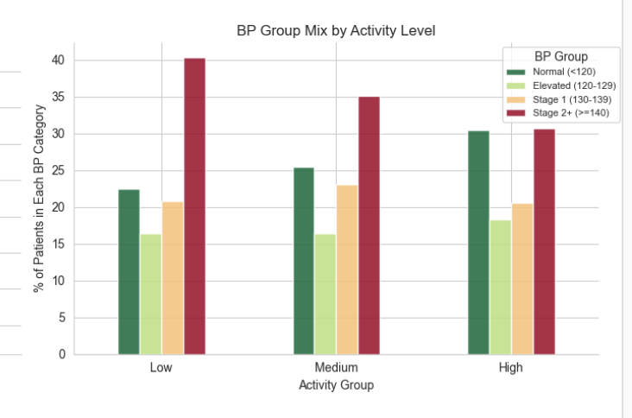
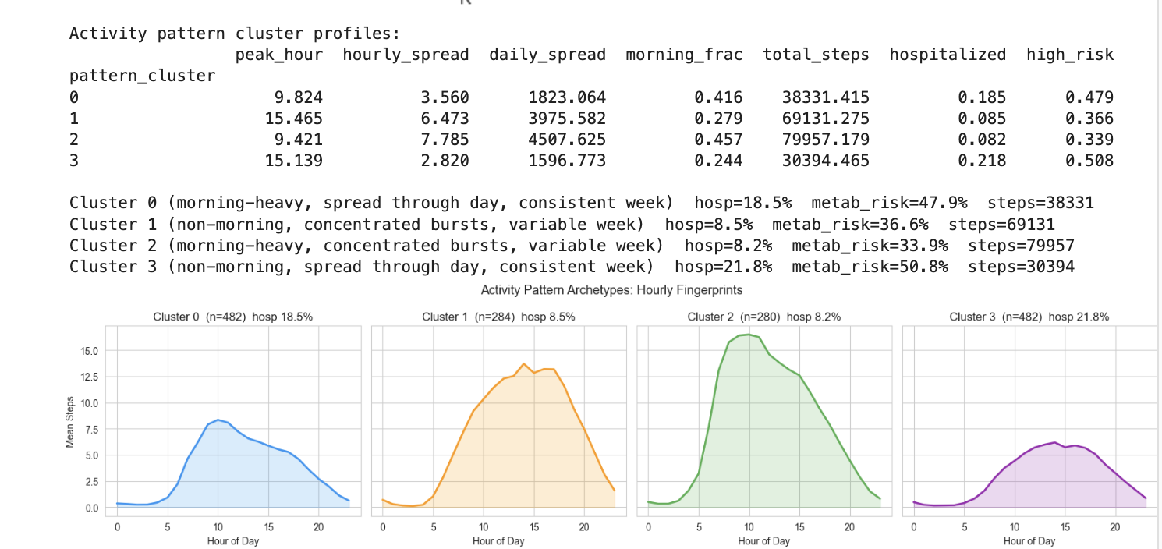
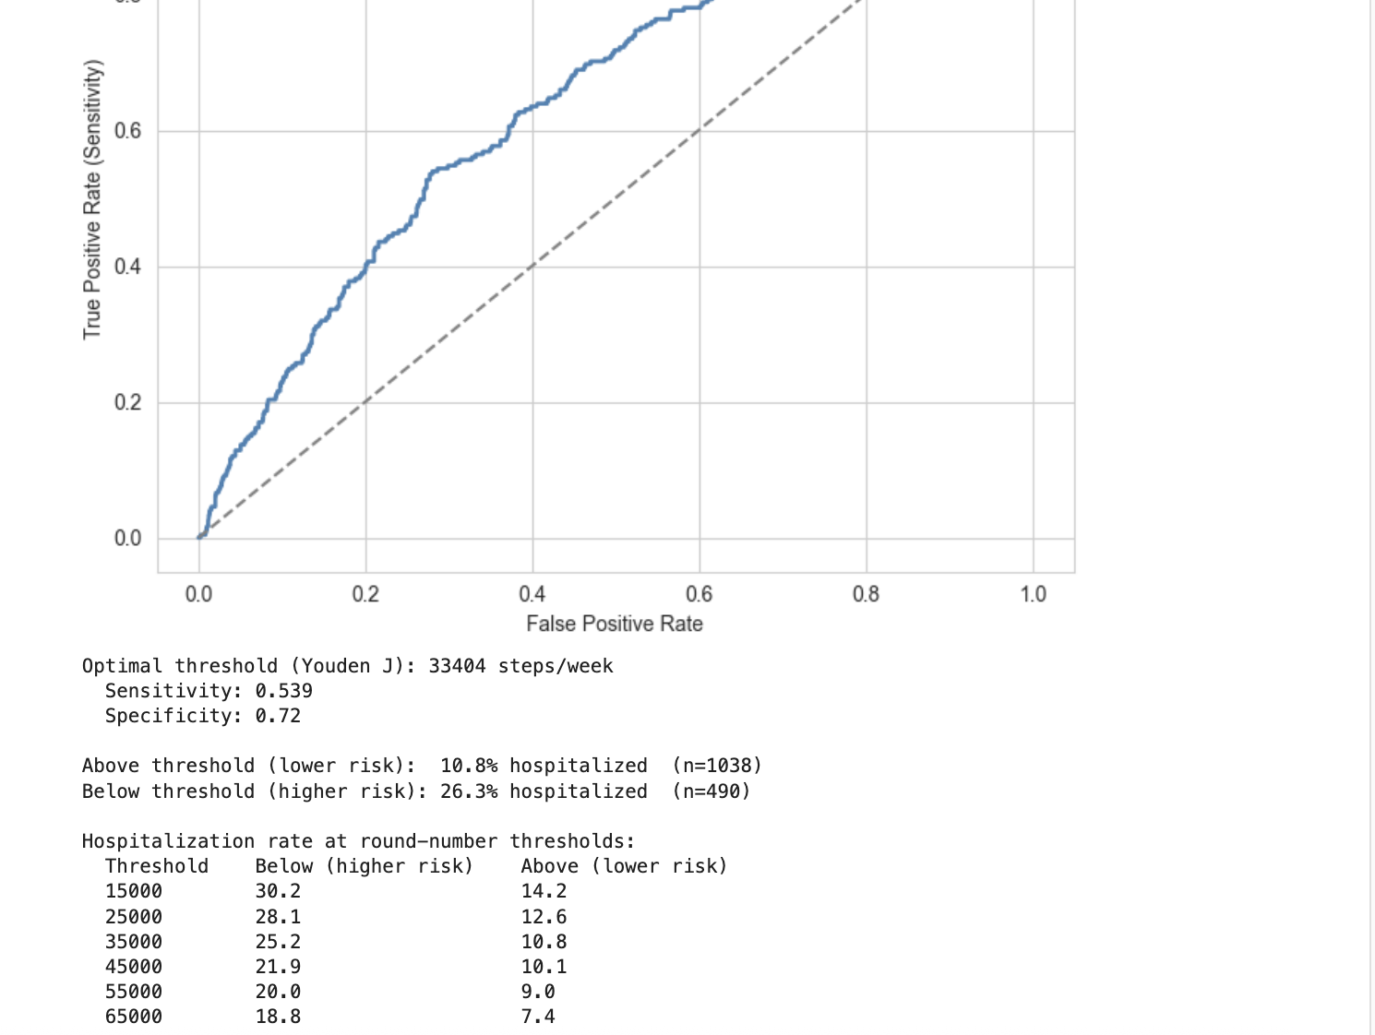
Some Final Findings
Activity does not have a high affect on hospitalization risk or Hypertension
When you move is not as important as how much you move
33,404 means steps is the optimal threshold of catching hospitalized patients (54%) and preventing false negatives (28%). Staying above that per week might be recommended but there isn’t enough data to say that the threshold is statistically significant.

Slide 11
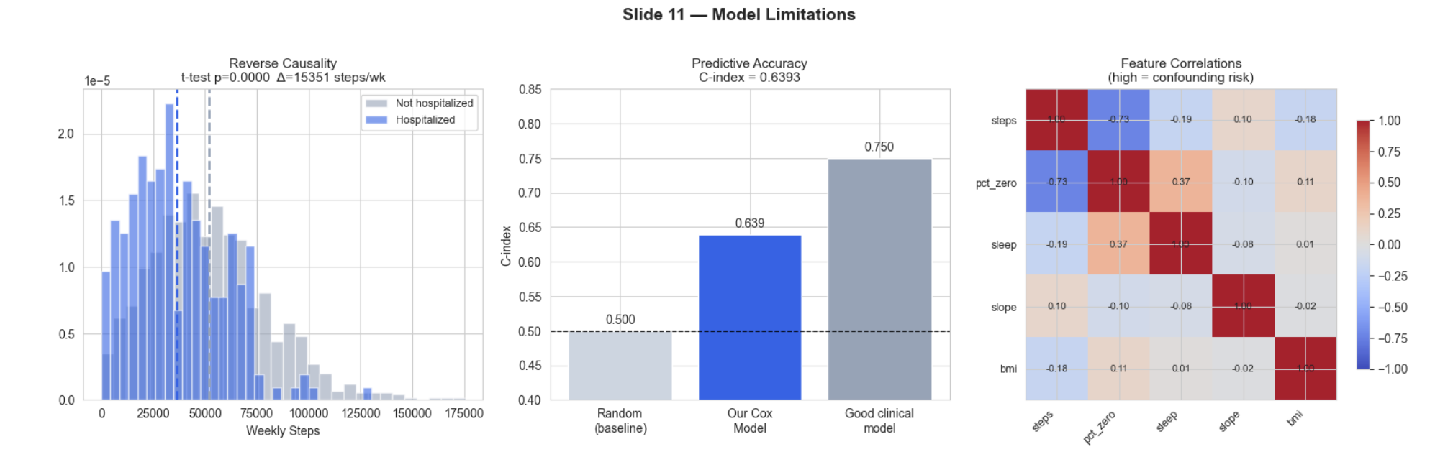
What We Got Wrong
Even so:
The step gap is 15,000/week and statistically airtight.
There is a signal. We just cannot prove its direction.
Other limits:
C-index = 0.639 — better than chance, not reliable enough to act on
One week of data · Adults 50–85 only · No heart rate
Reverse Causality
Hospitalized patients averaged 36,500 steps/week vs 51,800 for non-hospitalized.
But the accelerometer was worn after hospitalizations.
Someone hospitalized for a chronic illness may walk less because they are already sick.
Low activity could be a symptom, not a cause.

Slide 12
Live Simulation
Built from the exact Cox model coefficients.
Inputs:
Morning, midday, and evening step rate (steps/hour)
BMI
Model:
Derives weekly steps, % sedentary time, and sleep proxy from inputs
Applies Cox coefficients to get relative risk vs median patient
Converts to Poisson probabilities of 0, 1, 2, 3+ hospitalizations
Output:
Estimated chance of hospitalization in the next year
Estimated systolic BP (correlation-based, not Cox model)
C-index 0.639 — approximate only, not a medical tool

